Slide 1
Stray Animal Rescue Center
AED Final Project
Qing Mu
Xuan Gao

Slide 2
Content
Background
Purpose
Introduction
Object Model
Show Time
Report
Thinking
Q&A

Slide 3
Background
More and more people want to have a pet.

Slide 4
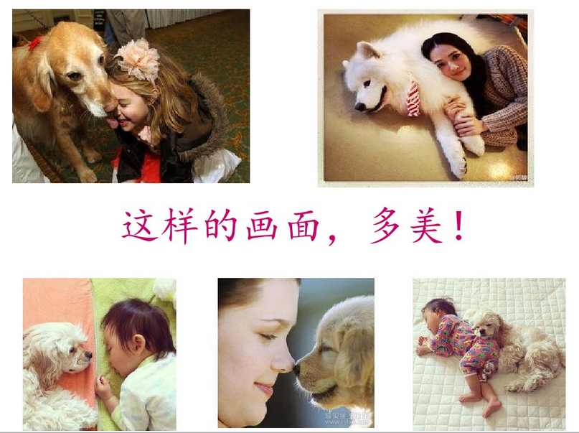
So lovely!

Slide 5
Background
More and more people want to have a pet
But more stray animals present, especially in China.

Slide 6
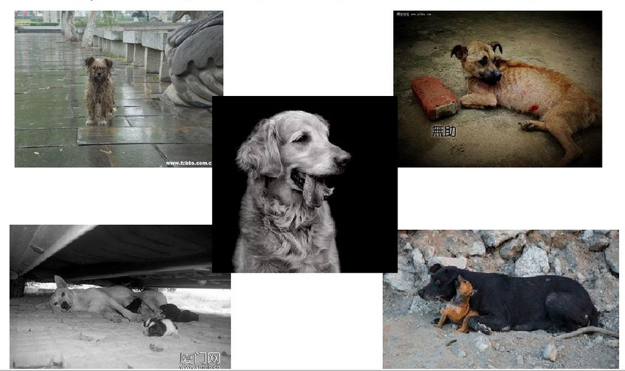

Slide 7
Background
More and more people want to have a pet.
But more stray animal present, especially in China.
Stray animals also bring some problems to people, such as:
Disturb and hurt people
Carry disease
Pollute environment
Affect the transportation
Really essential to set up Rescue Center

Slide 8
Background
More and more people want to have a pet.
But more stray animal present, especially in China.
Stray animals also bring problems.
We want to focus on this phenomenon and design a system for the rescue center to protect these animals, even benefits everyone.

Slide 9
Purpose
Analyse this phenomenon.
Design the Stray Animal Rescue Center System.
Reach a conclusion according to the actual situation.
Bring forward a way to solve the problems.

Slide 10
Introduction- Hierarchy
System
Boston
Eco-system
Network
Organi-zation
Enterprise
Rescue Center 1
Rescue Center 2
Registration
Veterinarian
Cage
Shelter
Adoption Inspector
Delivery
Pharmacy

Slide 11
Introduction- Roles
System Administrator – manage system
Enterprise Administrator – manage enterprise
Receptionist – register new animals
Veterinarian – treat animals
Pharmacist – dispense medicine for treatments
Veterinarian Assistant – review animals in cages
Shelter Staff – manage animal in shelters
Adoption Inspector – evaluate applicants
Delivery – delivery adopted animals
Adopter – adopt animals and see whole progress

Slide 12
Object Model

Slide 13
Welcome to our
Stray Animal Rescue Center!

Slide 14
Report
Stray cats more than dogs
Unhealthy more than healthy
Posh dog more than breed ones
Buy a new pet more than adopt one
Sterilization is the best way to control quantity
Rescue center always full in reality
Then?
Euthanasia!

Slide 15
Thinking
Why there are so many stray animals?
Abandon, because of health, moving, etc.
Be lost.
Over-reproduction.

Slide 16
Thinking
What is the people’s attitude for stray animals?
According to some surveys:
73.3% : sympathy but did nothing
12.44%：feed
1.58%: call the rescue center
5.88%: feel nothing

Slide 17
Thinking
Do people want to adopt a stray animal?
55.66%: it depends.
30.54%: Yes, I want!
13.8%: No, of course not!

Slide 18
Thinking
How to solve these problems?
Be responsible for your pet. When you decide to have a pet, think carefully.
Buy a tag for your pet in case of lost.
Do sterilization for your dog if you don’t want to have more pets.
Help stray animals and call local rescue center.
Adopt rather than buy one.

Slide 19
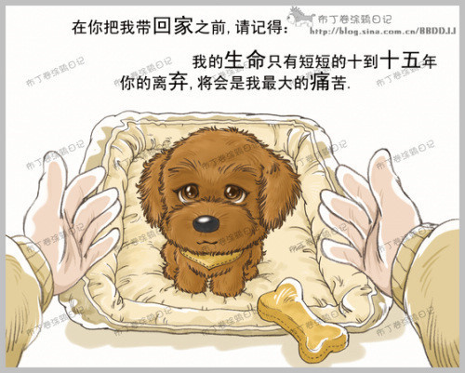
Before you bring me home, please remember:
my life only lasts for a short ten to fifteen years, to which your forsaking would be the greatest pain.

Slide 20

When I get old, please take good care of me as you always do. We all grow old.

Slide 21
Thank you!
We wish you a Merry Christmas & Happy New Year !
Qing Mu
Xuan Gao

Slide 22
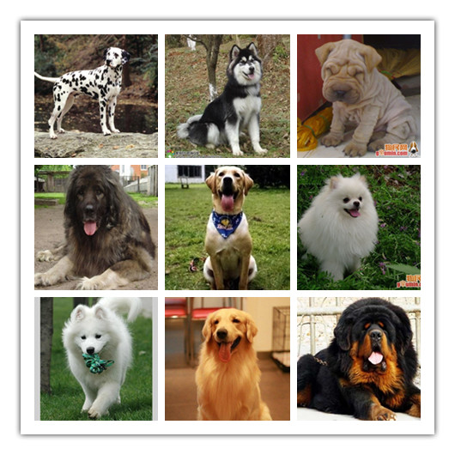
Q&A
?

Slide 23
Improvement
You can see there are two status in cage panel. If the status is bad, the animal can be sent to the veterinarian again for future treatment.
There maybe more functions on the Shelter staff panel. For example, we can record the information about feeding, cleaning and so on.
For the pharmacy panel, we analyze the medicine’s quantity and type. Maybe we can add functions like buying medicines.

